Slide 1

Module 5
Convolutional Neural Networks
Notes:
Guidelines
Use section headers to chunk content in your presentation.
Use the same style of section header throughout your presentation.
Keep your title to no more than 2 lines.

Slide 2
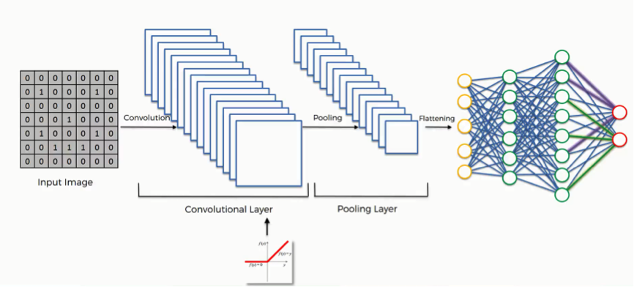
DL: Convolutional Nets
Notes:
Guidelines
Use a title slide at the beginning of your presentation. There are 9 variations of title slides to choose from.
If you will have a series of slideshows, we recommend using the same style of title slide for each presentation.
Keep your title to no more than 2 lines.
Do not change the font style or font size of the title or subtitle.

Slide 3
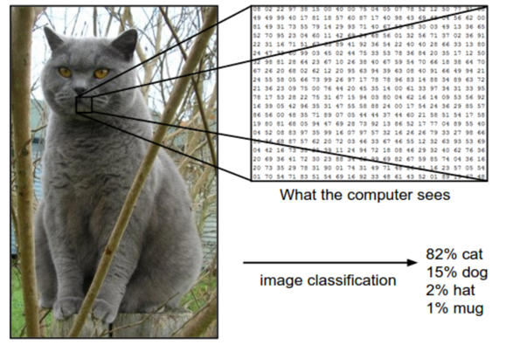
Image Representation
We know images are represented by tensors
A colored pixel is represented as three separate values (RGB).
3 matrices (tensor) represent red (R), green (G), blue (B) channels.

Slide 4

Image Representation
Channels can be flattened to create a single vector.

Slide 5
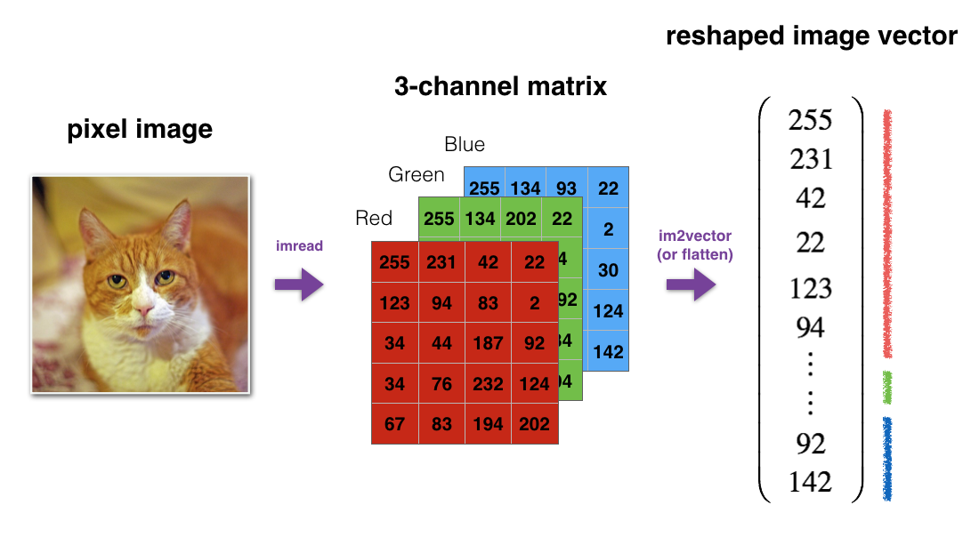
Image Representation
Channels can be flattened to create a single vector.

Slide 6
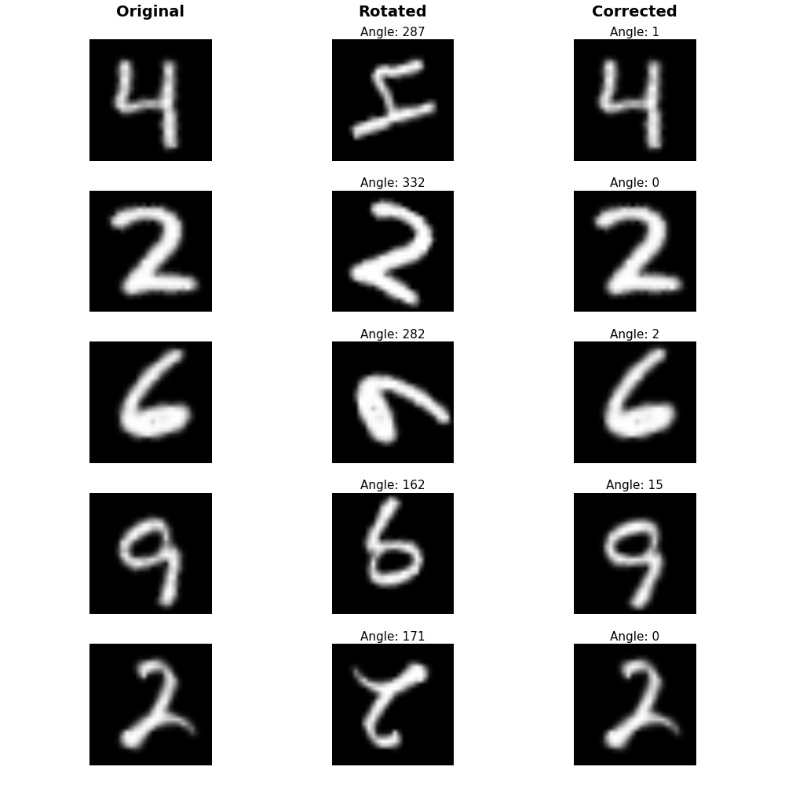
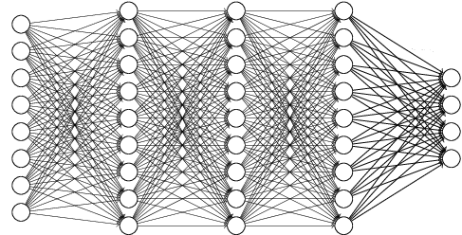
Using Feed-Forward NNs for Images
Feed forward NNs are not very effective with images

Slide 7
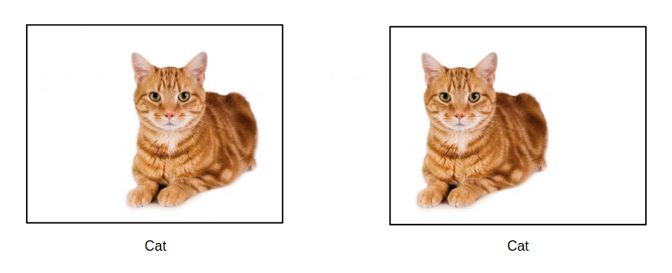
Using Feed-Forward NNs for Images
Translation Invariance

Slide 8
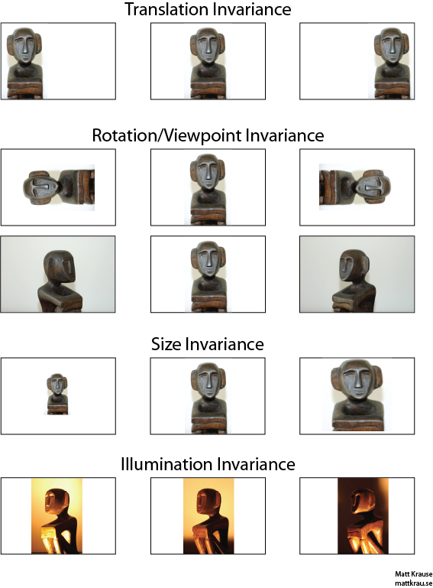
Using Feed-Forward NNs for Images
Other Invariances cause issues

Slide 9
Using Feed-Forward NNs for Images
Other Invariances cause issues

Slide 10
Using Feed-Forward NNs for Images
Flattening tensors create an enormous amount of features.
Predictive power declines with the added parameters estimated.

Slide 11
Python
Notes:
Guidelines
Use a title slide at the beginning of your presentation. There are 9 variations of title slides to choose from.
If you will have a series of slideshows, we recommend using the same style of title slide for each presentation.
Keep your title to no more than 2 lines.
Do not change the font style or font size of the title or subtitle.

Slide 12
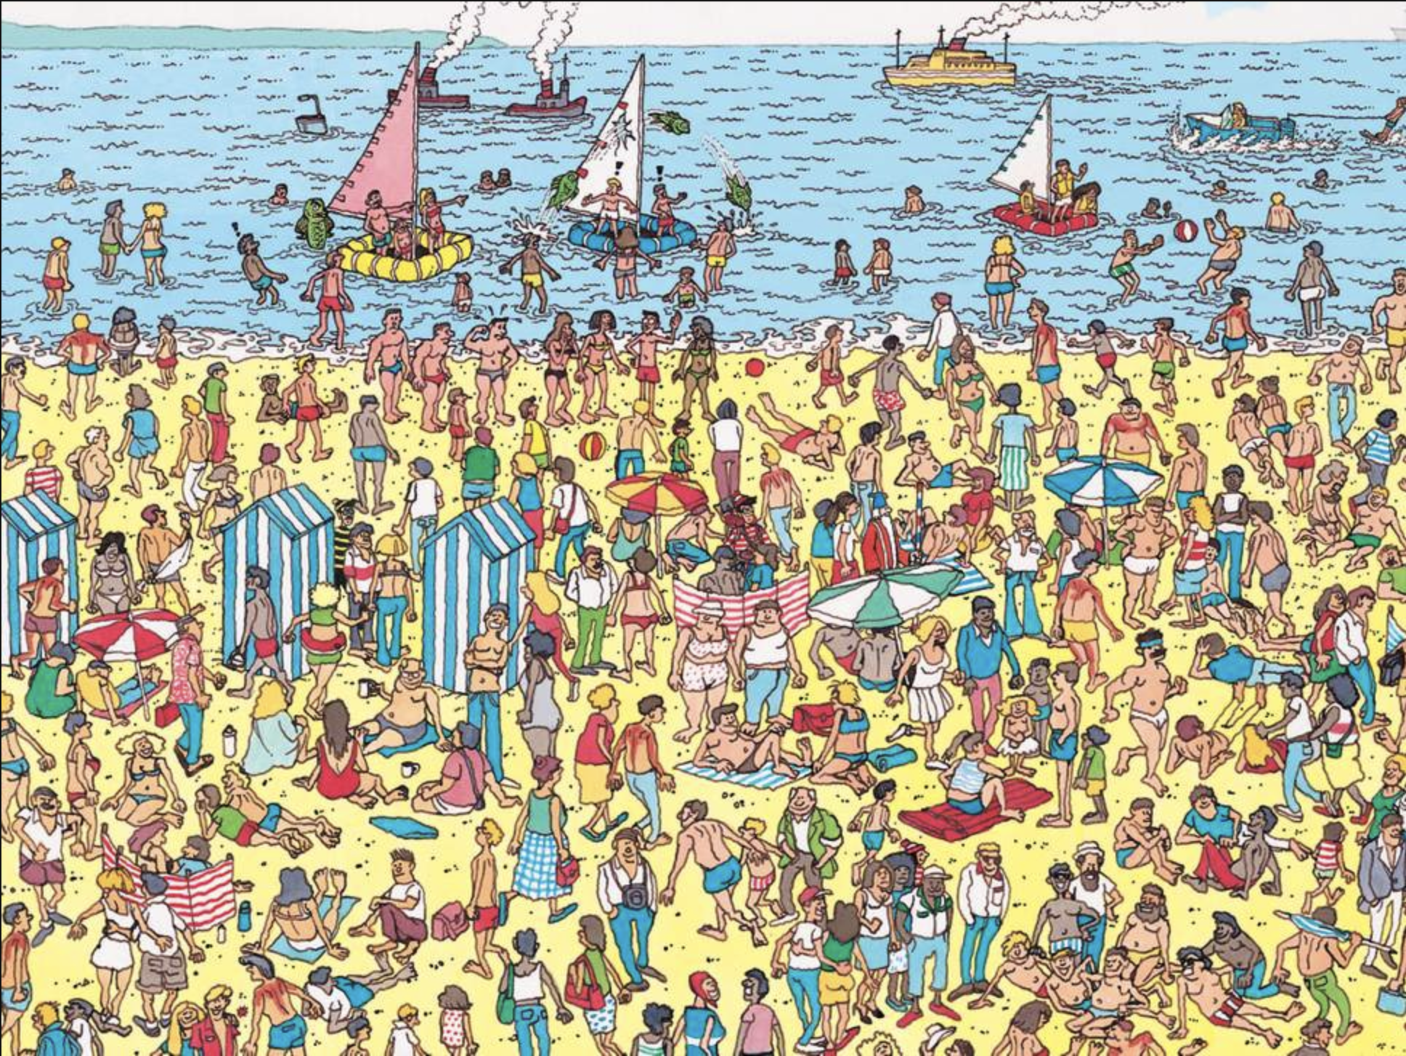

Convolutions (think about Waldo)

Slide 13
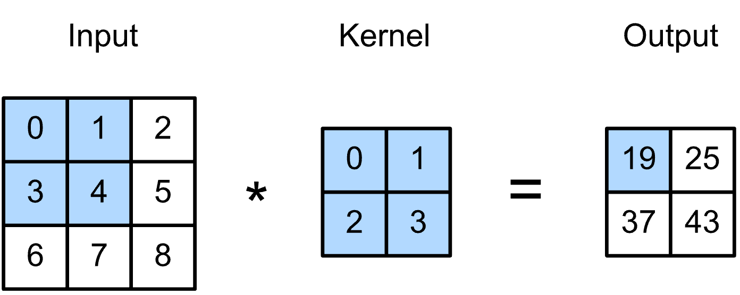
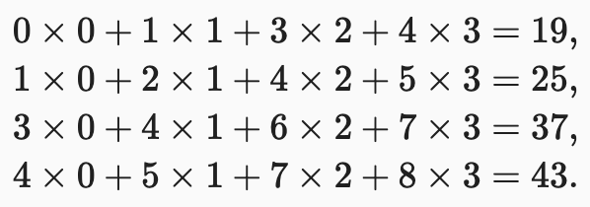
Convolutions
A convolution (kernel, mask, filter) is a small matrix used for blurring, sharpening, embossing, edge detection

Slide 14
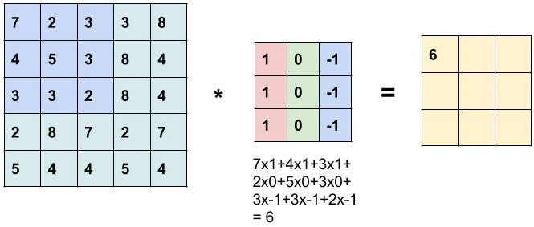
Convolutions
Convolutions go over the image and produce an output

Slide 15
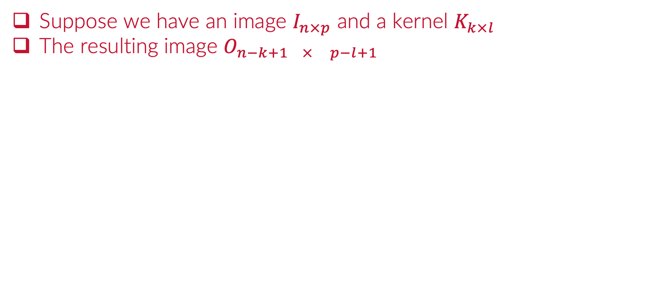
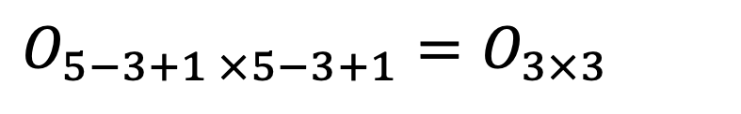
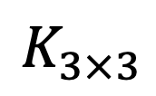
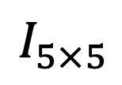
Convolutions
Suppose we have an image $I_{n×p}$ and a kernel $K_{k×l}$
The resulting image $O_{n−k+1 × p−l+1}$
$$I_{5×5}$$
$$K_{3×3}$$
$$O_{5−3+1 ×5−3+1}=O_{3×3}$$

Slide 16
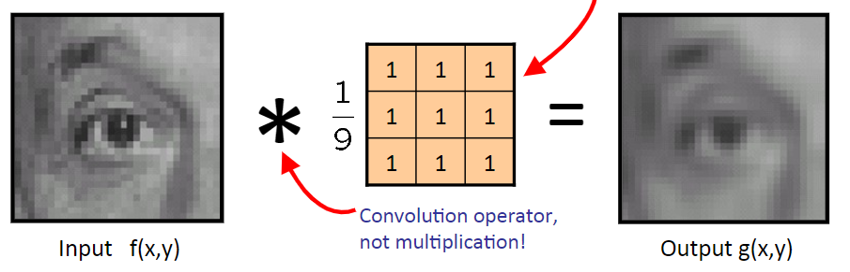
Convolutions Use
Convolutions can blur (downsample) images

Slide 17
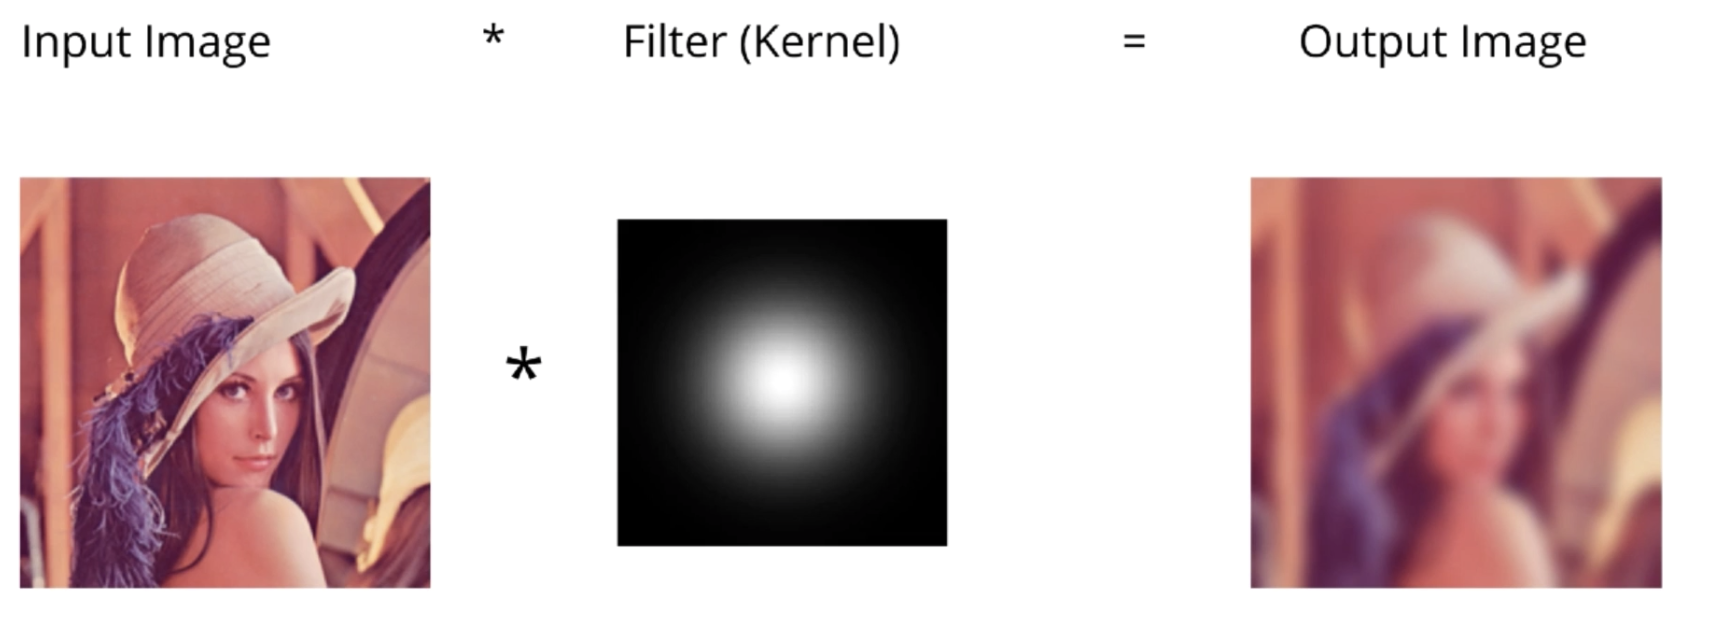
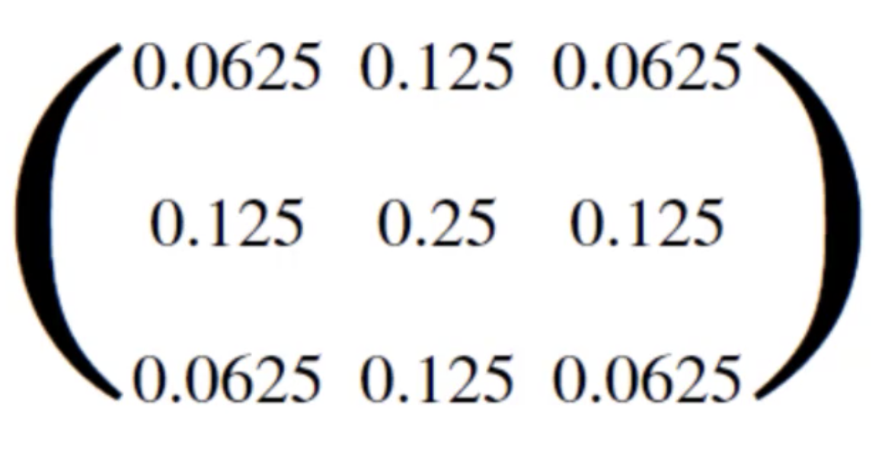
Convolutions Use
We can create multiple levels of blurring
In other words, create multiple images of the same one.

Slide 18
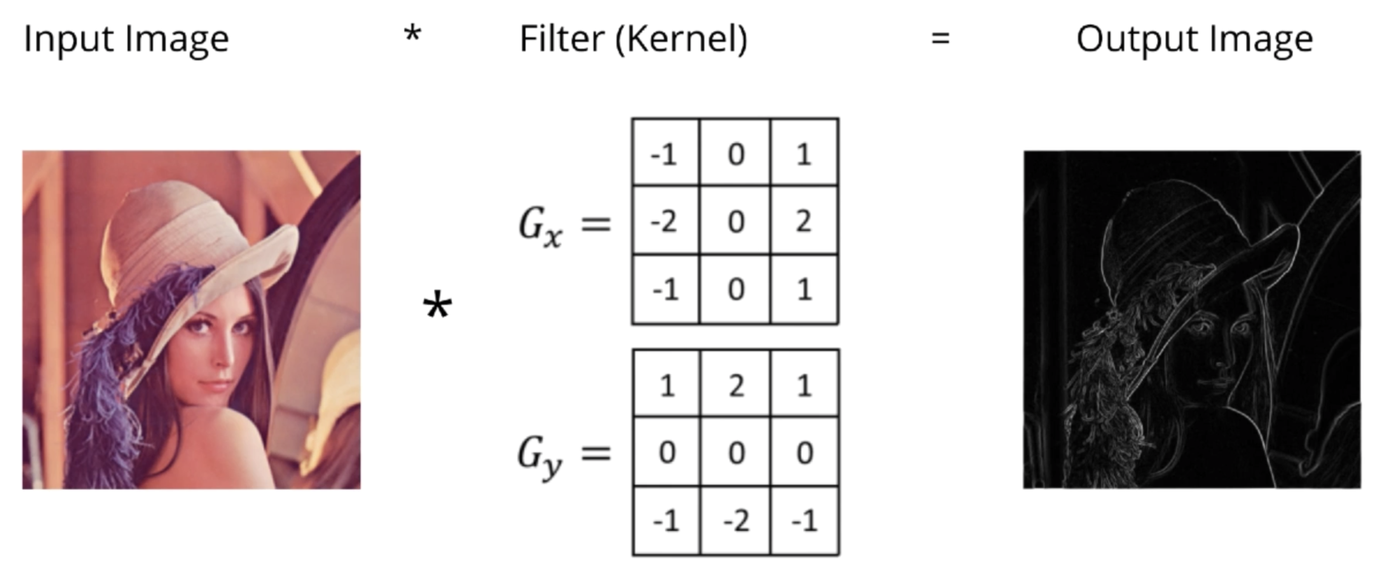
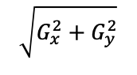
Convolutions Use
We can also better detect edges.
$$\sqrt{G_{x}^{2}+G_{y}^{2}}$$

Slide 19
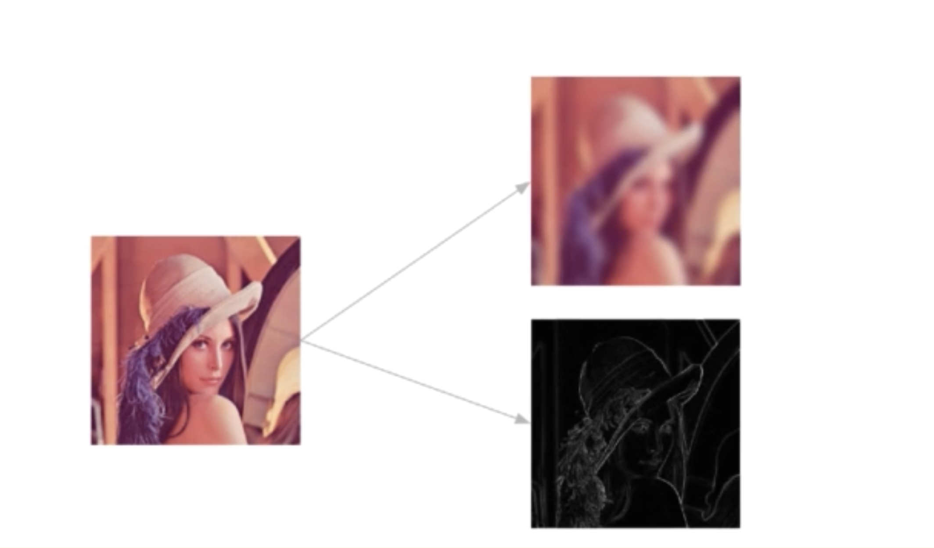
Convolutions Use
Convolutions work to create new features.

Slide 20
Convolutions Use
When we combine multiple convolutions we create a convolutional layer.

Slide 21
Convolutions Use
When we combine multiple convolutions we create a convolutional layer.

Slide 22
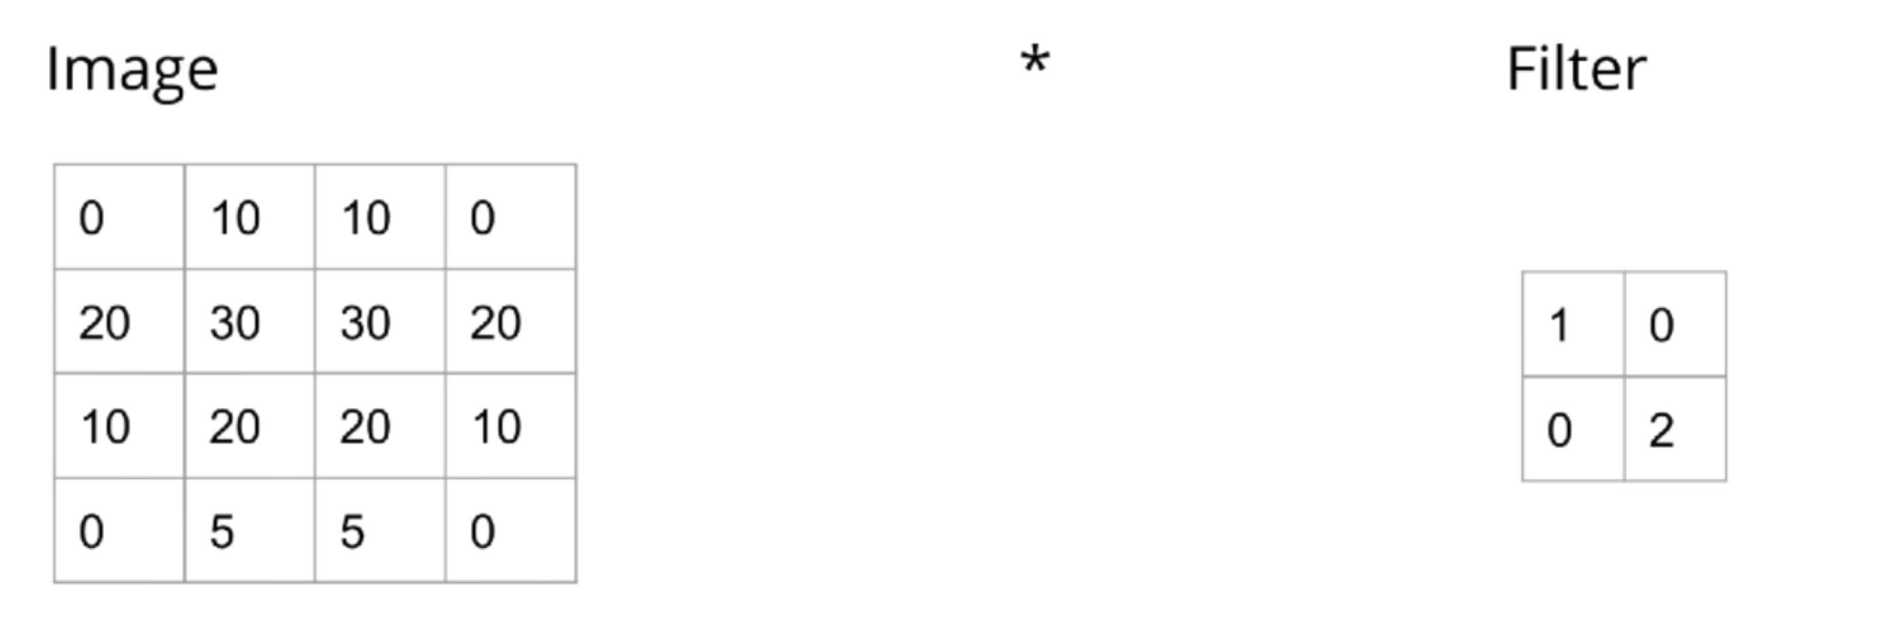
Example
Suppose we have the following image and convolution.

Slide 23


What is the resulting output image shape
ⓘ Start presenting to display the poll results on this slide.

Slide 24
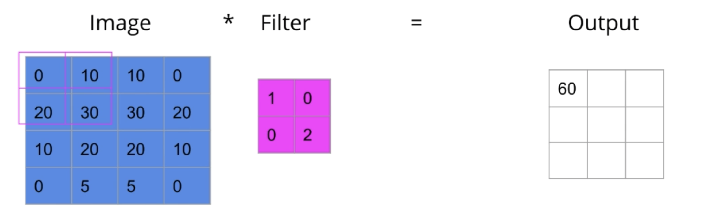
Example
Suppose we have the following image and convolution.
X

Slide 25
What is the value of X?
ⓘ Start presenting to display the poll results on this slide.

Slide 26
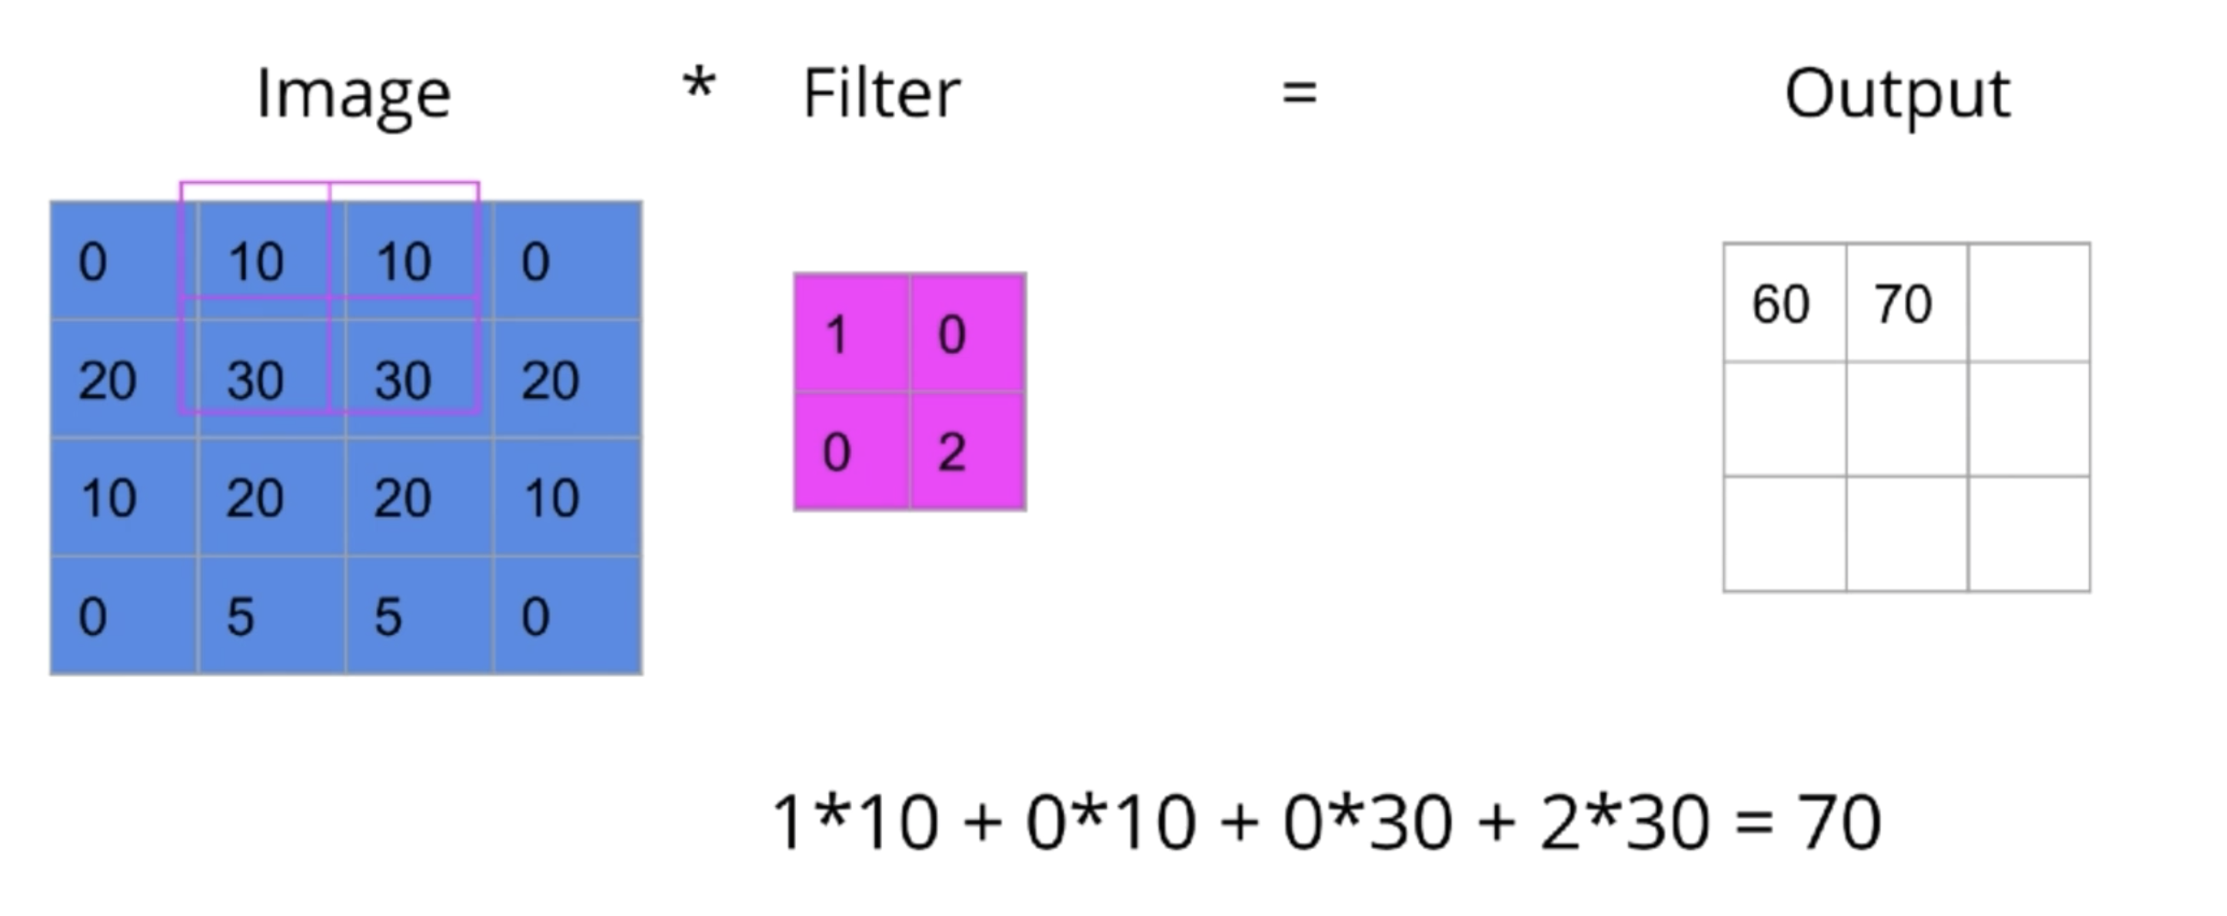
Example
Suppose we have the following image and convolution.
X

Slide 27
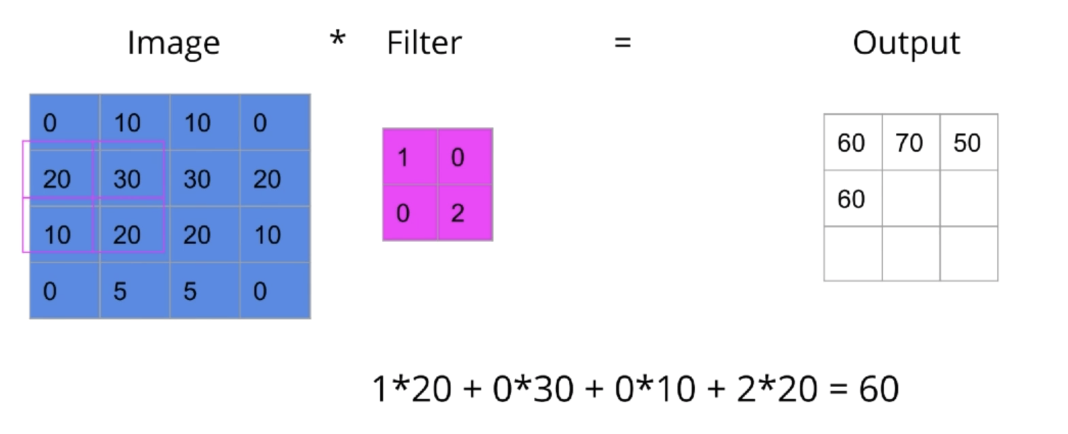
Example
Suppose we have the following image and convolution.
X

Slide 28
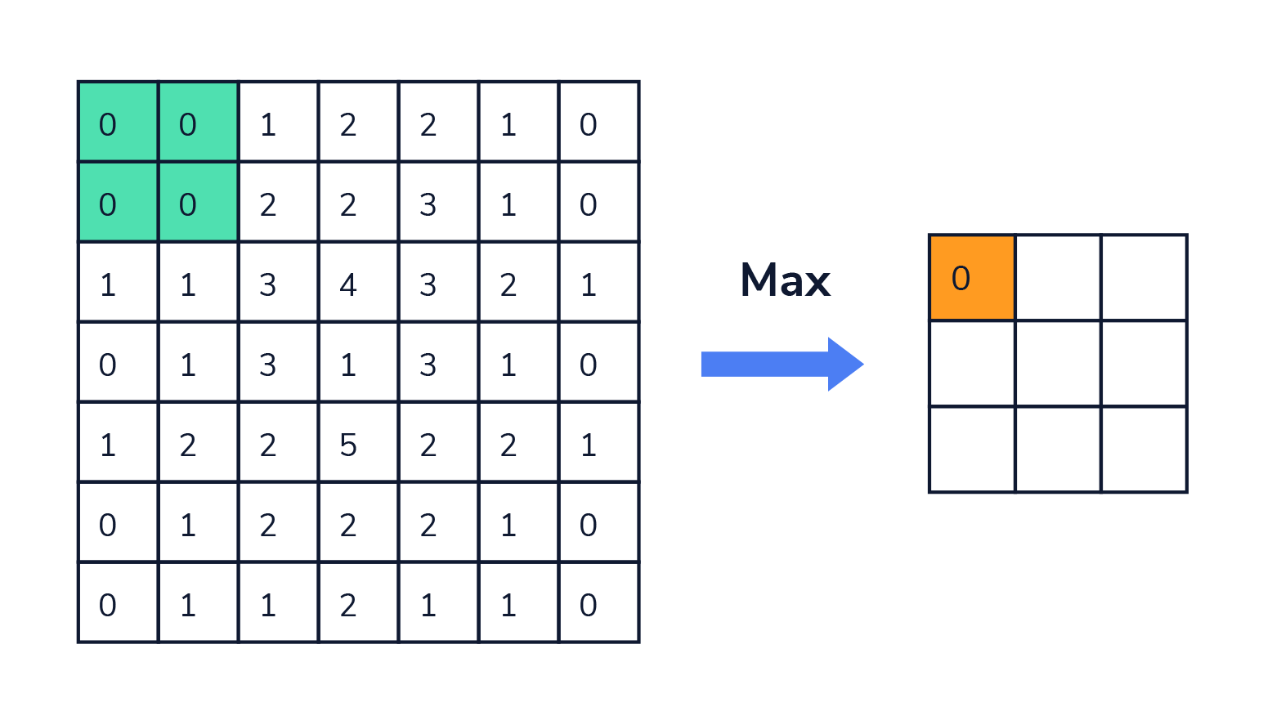
Pooling Filter
Pooling is also used to downsample the images
Pooling filters keep the important parts of the images.
Max, Min and Average Pooling Filters are the most common

Slide 29
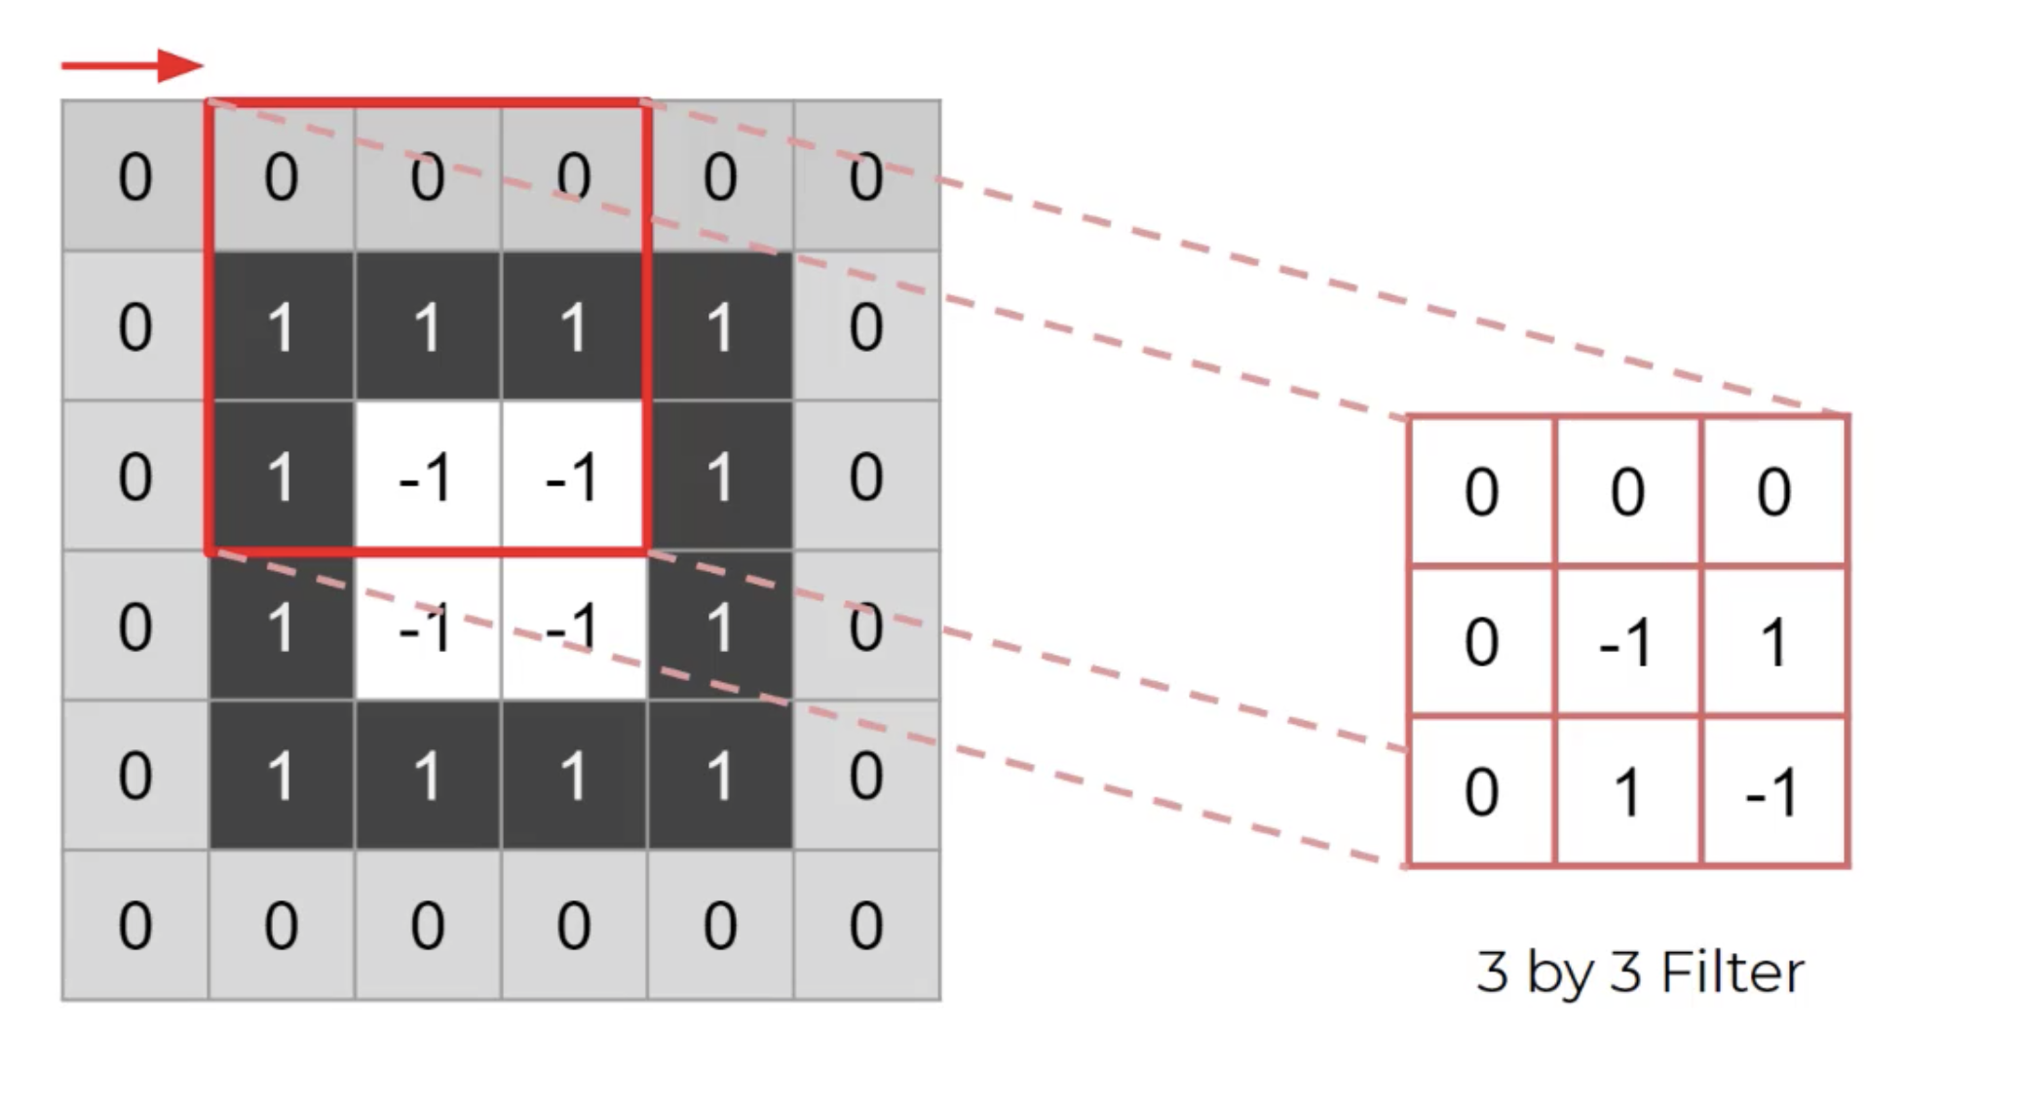
Stride
Dictates the movement of the kernel, or filter, across the image
Example of (1,1) stride (most common)

Slide 30
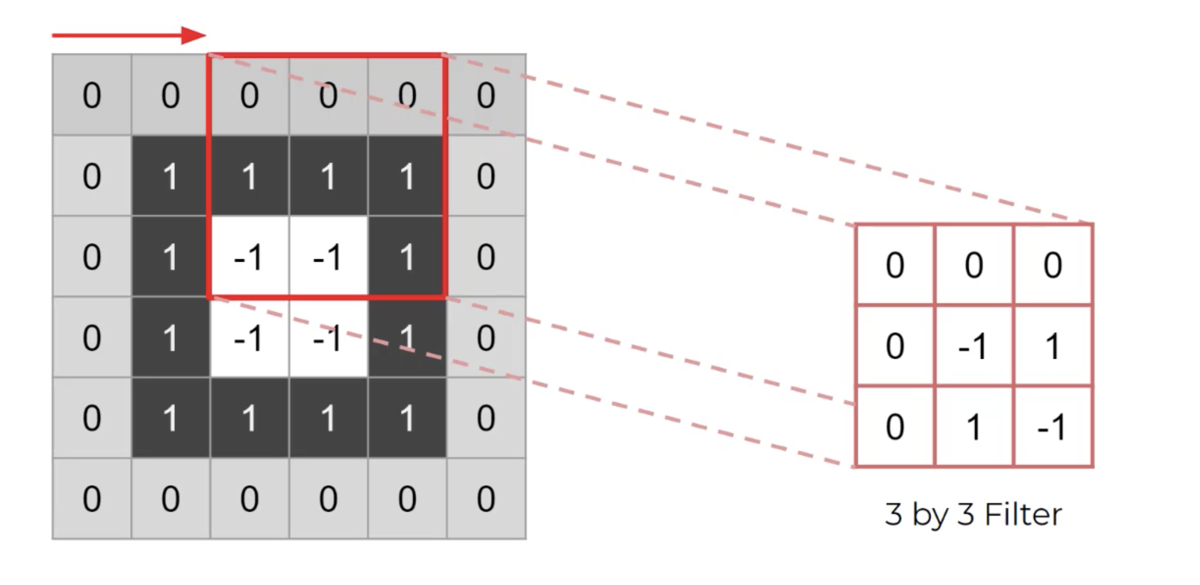
Stride
Example of a (2,2) stride

Slide 31

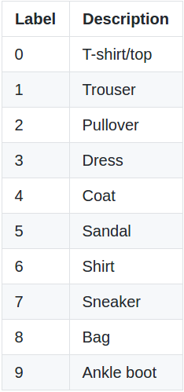
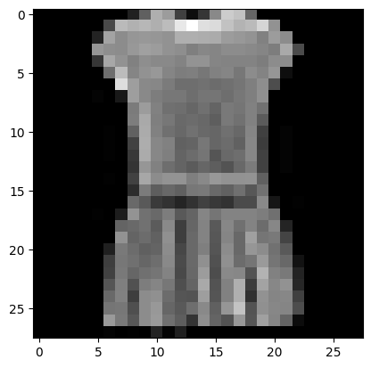
Final CNN Product
We combine multiple convolutional layers and pooling layers
We just set the size of the kernels
We let the network optimize values of the filters
We flatten and add a feed-forward neural net for further accuracy.

Slide 32
Final CNN Product
We combine multiple convolutional layers and pooling layers
We just set the size of the kernels
We let the network optimize values of the filters
We flatten and add a feed-forward neural net for further accuracy.

